Slide 1
NOTES
FULL
Super
Savvy
Simplified
Inferential Statistics:
The Difference Dynamic
Descriptive = describe the sample. Inferential = make statements (inferences) and predictions about the population based on the sample data.
Estimation
Estimating the characteristics of a population from sample data
How likely is it that your sample data reflects the population?
Significance Testing
Testing for significant statistical differences between groups OR statistical relationships among variables
How likely is it that your findings occurred by chance?
As a researcher, you don’t want your findings to occur by chance, you want them to occur because you actually found the right answer!

Slide 2
Hypothesis: Make a Prediction!
The Hypothesis
H1: Laptop and tablet users will differ in their likelihood to make a digital purchase. The Null Hypothesis --- The One You Want to Reject Ho: Laptop and tablet users will not differ in their likelihood to make a digital purchase.

Slide 3
Significance Level Setting a Decision Point
The degree of error the researcher finds acceptable in a statistical test
An estimate of what would happed if the study were actually repeated many times
Also called the P-Value (Probability Level)
In social science/ market research, it has been set for you
(p <.05) is the accepted level
Less than 5% likelihood that our findings occurred by chance
Sidebar: for medical research, it is much more strict (cannot say 5 in 100 will die)
Social scientists can be a little more loose
The P-Value helps determine the CV (Critical Value)
Critical Value= the decision point or cut off

Slide 4
Hypothesis Testing Making a Decision
Looking at your scores (91%)
And then comparing the H to the decision point
(Example)
100%-92% = A
91%-75% = B
74%-60% = C
Chris got a 91%=B, not an A ☹
From the data you obtained, testing whether or not your number meets the criterion

Slide 5
Hypothesis Testing (continued…)
 | Ho Probably True | Ho Probably Not True
Accept H0 | Correct = …meh😐 you did the right thing but your H just got dumped! | Type 2 Error Beta Error (losers)
Reject H0 | Type 1 error Alpha Error (LIARS) You think you found something significant but you didn’t really (example) you thought 91% was an A but it wasn’t | Correct = yay!! ☺ Your H/RQ is supported – yay!! This is where you wanna be!

Slide 6
Tests of Difference
Testing
for differences
Chi-square
χ²
t-test
t
ANOVA
F

Slide 7
The T-Test
When to do a T-Test
Steps in the Analytical Process
Determines if the TWO groups/ categories of the IV significantly differ on the DV
IV= List all the categories! (make it sound categorical) [nominal]
DV= make it sound continuous
Only do a T-Test if there are two groups
Variables determine whether or not you do this test
1. Compute the appropriate statistical tests to determine if a difference exists (t-test)
2. Examine results to determine if the difference found is in the direction you predicted
3. Determine if the difference is statistically significant
Compare your resulting # to the critical value
Critical value= the smallest possible # to pass the statistical test
Example: C=70%
IMPORTANT: if you end with a negative t number, use disregard the (-) sign [i.e., use the absolute value] when comparing the t to the CV

Slide 8
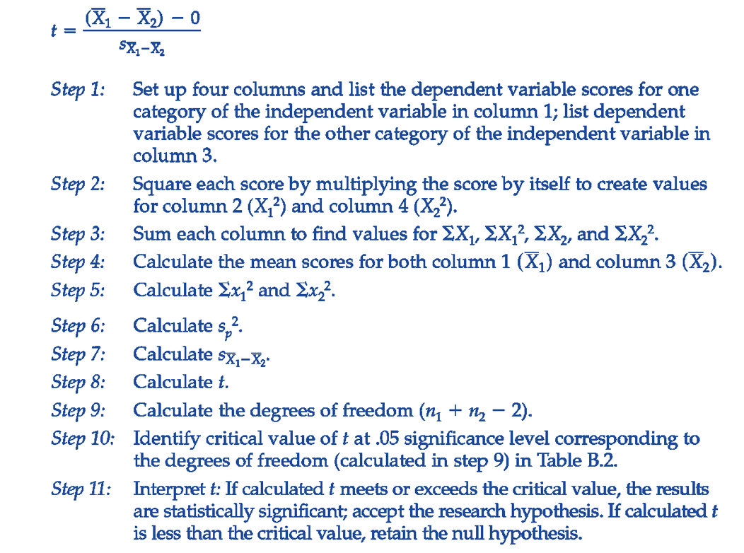
Steps For A T-Test

Slide 9
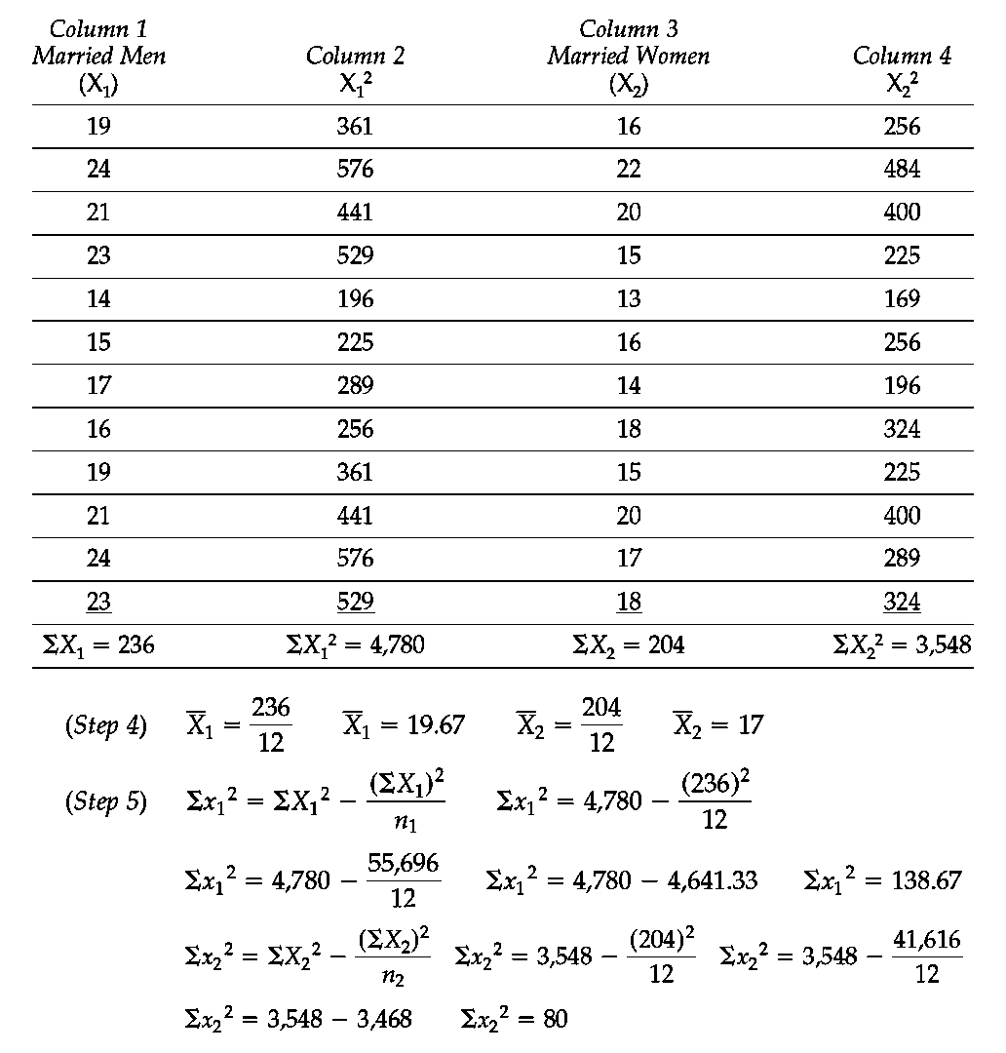

Slide 10
